Slide 1
YggFinance
Progress Update

Slide 2
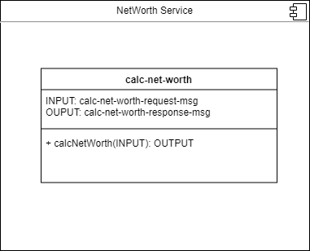
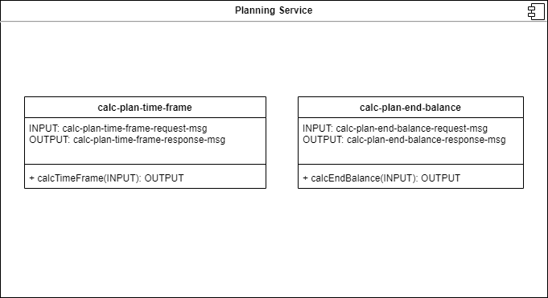
Services - To be Implemented
Monthly Budget
Savings Planner
Net Worth

Slide 3
Functions - Completed
The two functions of the Planning service have been written and tested some
Two functions are calcTimeFrame() and calcEndBalance()
The Monthly Budget service has been written besides CSV implementation
Function parseCSV() partially implemented
The Net Worth service portion for receiving inputs has been implemented, along with the calculation

Slide 4
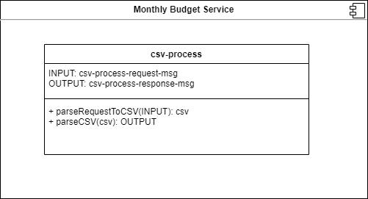
Services - Changes
No changes to the services as of yet, there are a couple of challenges to explore.

Slide 5
Services - In Progress
Planning service output format not yet implemented
Need a filter for the CSV file to get only needed data
JSON message formatting for Net Worth service incomplete
Each service needs to be containerized for Docker

Slide 6
Services - Potential Issues
It will be a challenge to figure out how to filter out unnecessary data from the CSV files
One possible solution would be to configure the CSV parsing to fit a specific format directly related to a specific financial institution
// set fields
hasHeaders: boolean
merchantColumn: string
amountColumn: string
dateColumn: string
// appended files
file: file
csv-process-response-msg

Slide 7
Yggdrasil Server - Issues
Host on LAN? Easy and lots of experience with!
Q. how about opening it to the internet?
A. Have fun with that!
Issues:
Port Forwarding
Domain acquisition
Static IP Addresses
Public IP Addresses
A Headache...

Slide 8
Yggdrasil Server - Issues (cont.)
Q. How about using AWS?
Issues:
High Learning Curve
Pricing is impossible to figure out (free? Or $0.36? Or what?)
Too many services (you can do the same thing in 5-10 different ways with different costs)
Q. How about another Hosting Provider?
Try to find a free VPS, it’s hard and often incredibly limited…
We decided to direct our efforts elsewhere on this front.

Slide 9
Yggdrasil Server - Solution
The solution? Tunneling to a proxy!
Local Tunnel
No need to open router ports
All traffic is wrapped in a TLS tunnel to the proxy server only.
No need to have a static or dedicated IP
The client application on our server is in continuous contact with the proxy server, so the router our server is connected to needn’t be configured to allow any special traffic through as it isn’t being directly accessed publicly.
Free choice of subdomain (3rd level domain) names assuming they aren’t currently in use.
Free and Open Source Software (FOSS)!
Https connection: https://yggfinance.loca.lt

Slide 10
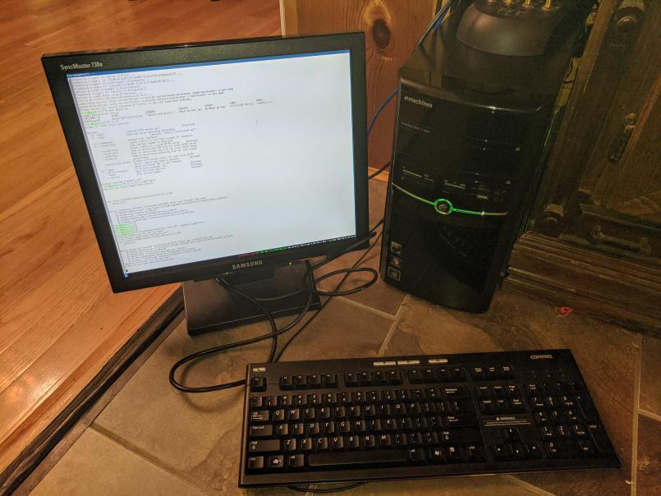
Yggdrasil Server - Completed
Yggdrasil Server Setup:
Machine: Emachines ET1331G-07w
OS: Ubuntu Server 20.04.2
apt:
docker
docker-compose
npm(Node Package Manager)
ruby
i3 desktop environment
openSSH server
npm :
localtunnel
ruby gem:
localtunnel-restarter

Slide 11
Yggdrasil Server - To be Completed
Docker:
DockerCompose Configuration File
Docker Network
Reverse Proxy nginx container
Integration and Deployment of completed project pieces.

Slide 12
Yggdrasil Server - Potential Issues
LocalTunnel likes to crash every once in a while (network instability)
Solution: localtunnel-restarter ruby gem
No experience setting up a reverse proxy before
DoSing/DDoSing?
First: We can change the subdomain name really easily so if it happens, we just change the url name
Second: Non-tunneled requests directly to the IP are dropped anyways as per standard.
Third: please don’t
Security?
The server has nothing on it other than the deployed docker images, is on a vLAN of its own, and is connected to purely over what amounts to a reverse VPN, so it will most likely be secure enough for the purpose of demoing the project.
Don’t take that as a challenge, this isn’t enterprise grade stuff, it’s old consumer grade stuff.

Slide 13
YggFinance Web App - Changes
Using text fields for Monthly Budget data (EditTableAPI last updated 2017)
Text fields are actually part of MaterialUI
Using text field instead of adjustable slider for Savings Planner Page
Slider gives less freedom on available inputs (decimal values of years)
Dropdown menu for month names on Monthly Budget changed to a customized select
Functions the same, but is easier for data manipulation

Slide 14
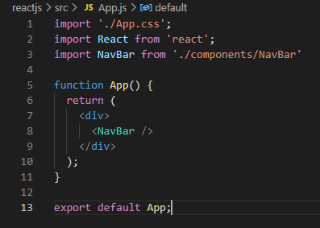
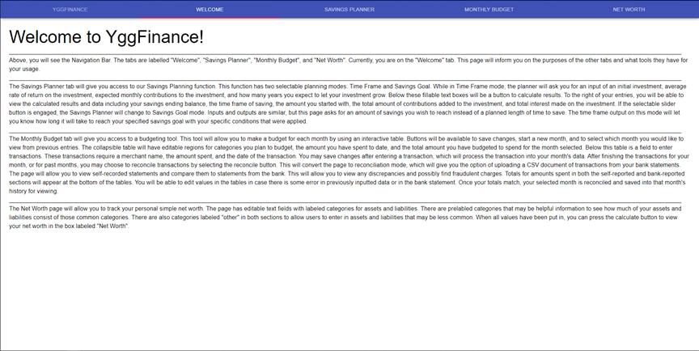
YggFinance Web App - Completed
Entirety of App contained within NavBar(Top Menu)
Allows the use of TabPanel to separate pages
Pages load simultaneously
Welcome Page
Full descriptions of all tools available
Savings Planner page
UI elements laid out. Prepared for data testing through server
Data tables are compartmentalized to their own .js script
Monthly Budget page
UI Elements laid out
Reconciliation currently disabled
History table compartmentalized to its own .js script

Slide 15
YggFinance Web App - To be Implemented
CSV file handling will be most difficult
Lack of CSV handling removes need for reconciliation option
Selectable data labels for currencies (select text fields)
Data input validation through the UI (helpertext)
Grid editing to prevent odd UI changes when changing window size

Slide 16
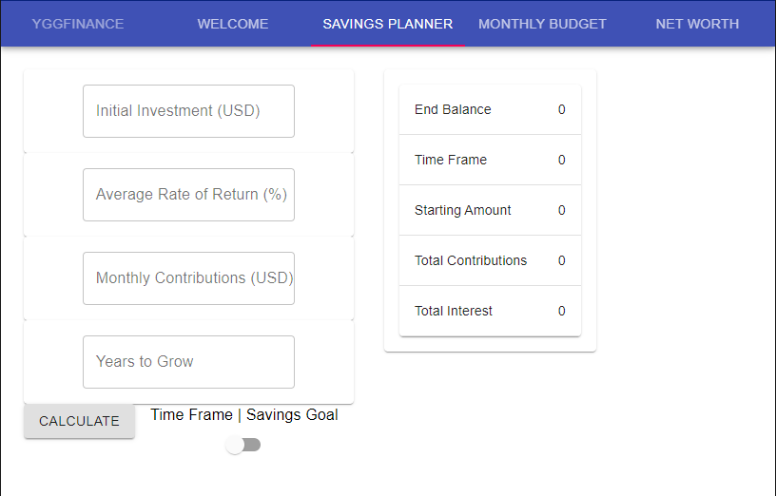
YggFinance Web App - In Progress
Testing data handling locally through Net Worth page
All other data will be transferred through server to back end
Dockerizing App pages for server communication
Attempt made to dockerize early on. Realized dockerization is best done after most of setup has occurred
Editing all pages to look more clean (professional)
Customization from defaults is a long process

Slide 17
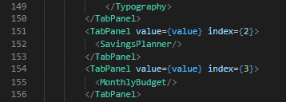
YggFinance Web App - Potential Issues
As data-handling components are compartmentalized to their own .js files, data communication of data between server and UI may be difficult
Stored user data will have to be loaded in upon opening the app (user log-in?)

